Slide 1

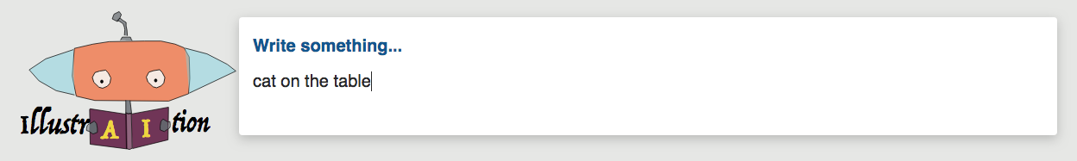
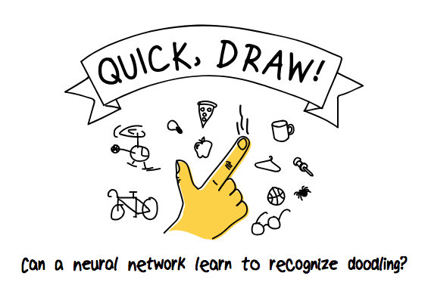
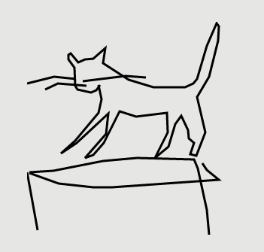
Ling Chen, Laura Colbran, and Ying Ji
Vanderbilt University
The frontend receives input.
Then the frontend draws the picture!
Doodles are labeled and filtered for quality using deep learning.
The backend takes the input, identifies phrases and near word matches, and processes the paths to combine them into an illustration.

Slide 2
Data
https://quickdraw.withgoogle.com/

Slide 3
Organization
Frontend
React.js
Backend
Django

Slide 4
Ling Chen, Laura Colbran, and Ying Ji
Vanderbilt University

